Slide 1
CS221.N12.KHCL VIETNAMESE EMOTION CLASSIFICATION
USING PHOBERT
Lecturer: Nguyen Duc Vu
Members:
Nguyen Phuong Duy - 20521242
Tran Nguyen Phuc Minh Quan - 20521475

Slide 2
CONTENTS
1.INTRODUCTION
2.MODELS
3.DATASET
4.PIPELINE
5.RESULTS
6.REFERENCES

Slide 3
Introduction
What is Text classification?
Types of Text classification
Relative Works

Slide 4
01
What is Text Classification?
Text classification is a also known as text tagging or text categorization is the process of categorizing text into organized groups. By using Natural Language Processing (NLP)

Slide 5
Type of classification
Sentiment Analysis
Topic Detection
Language Detection

Slide 6
RELATED WORKS
Năm 2012, Mohammad
Kratzwald
Năm 2017 Mohammad
Mô hình bộ phân loại (BLSTM-MC)
Năm 2018 Wang

Slide 7
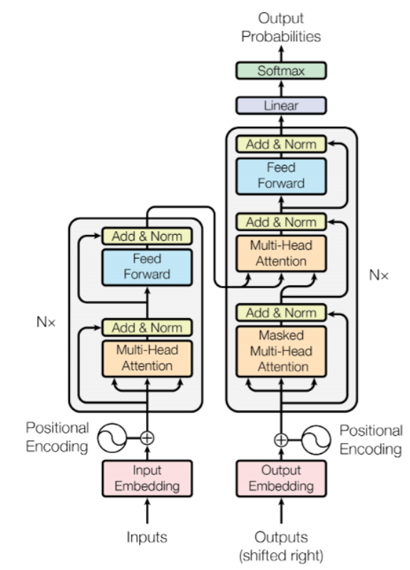
Transformers
A transformer is a deep learning model that adopts the mechanism of self-attention
It is used primarily in the fields of natural language processing (NLP)^{[1]} and computer vision (CV)

Slide 8
THE LOGIC BEHIND TRANSFORMER
Transformer use self-attention
Self-attention is a new spin on the attention technique.
Include 6 encoders and 6 decoders
Each encoder has self-attention and FNN

Slide 9
TRANSFORMER APPLICATIONS
Based for BERT
Video understanding
Document generation
Analysis
Document summarization

Slide 10


BERT
BERT (Bidirectional Encoder Representations from Transformers) is a recent paper published by researchers at Google AI Language
It has caused a stir in the Machine Learning community by presenting state-of-the-art results in a wide variety of NLP tasks, including Question Answering (SQuAD v1.1), Natural Language Inference (MNLI), and others.

Slide 11
THE LOGIC BEHIND BERT
an attention mechanism that learns contextual relations between words (or sub-words)
BERT
only the encoder mechanism is necessary

Slide 12

BERT APPLICATIONS
Increase the accuracy and GLU score
80.5%
MultiNLI data
86.7%
SQuAD v1.1
93.2%

Slide 13
PhoBERT
PHOBERT
Are the state-of-the-art language models for Vietnamese
“Base” and “large” version are the first public large-scale monolingual language models pre-trained for Vietnamese

Slide 14
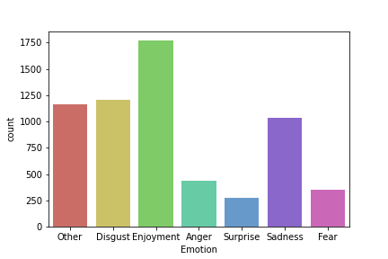
DATASET
UIT-VSMEC(Vietnamese Social Media Emotion Corpus)
-6927 sentences
-7 labels:enjoyment, disgust, sadness, anger, surprise, fear
Link : https://sites.google.com/uit.edu.vn/uit-nlp/datasets-projects?pli=1

Slide 15
PIPELINE
PREPARE
LOAD DATA
EXPLORATORY DATA ANALYSIS
SENTIMENT ANALYSIS
TRAINING
EVALUATION

Slide 16
RESULTS
Classification Report
Confusion Matrix
Comparison table

Slide 17
 | PRECISION | RECALL | F1-SCORE | SUPPORT
Ẹnjoyment | 0.66 | 0.68 | 0.67 | 193
Disgust | 0.60 | 0.66 | 0.63 | 132
Sadness | 0.63 | 0.67 | 0.65 | 116
Anger | 0.47 | 0.38 | 0.42 | 40
Surprise | 0.63 | 0.32 | 0.43 | 37
Fear | 0.69 | 0.67 | 0.68 | 46
Other | 0.54 | 0.54 | 0.54 | 129
ACCURACY |  |  | 0.61 | 693
MARCO AVR | 0.60 | 0.56 | 0.57 | 693
WEIGHTED AVG | 0.61 | 0.61 | 0.61 | 693

Slide 18
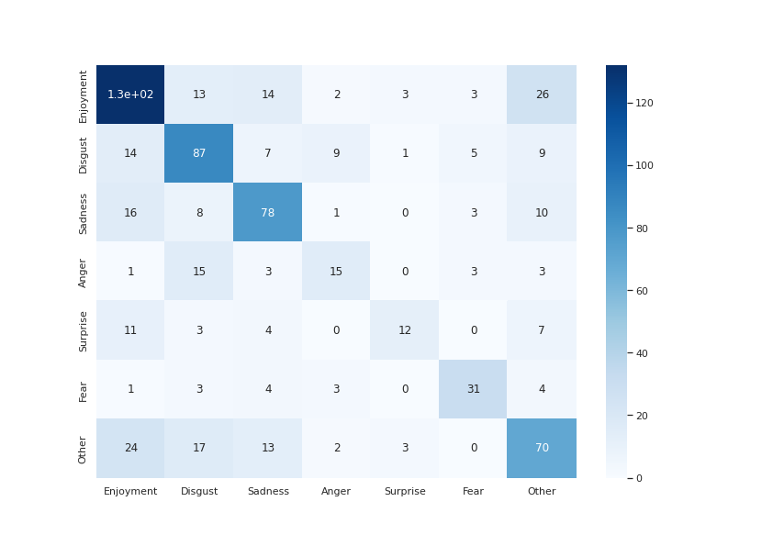
CONFUSION
MATRIX

Slide 19
Methods | Accuracy (%) | Weighted F1-score (%)
RandomForest +BoW | 50.64 | 40.11
SVM+BoW | 58.00 | 56.87
LSTM+word2Vec | 53.39 | 53.30
LSTM+fastTest | 54.25 | 53.77
CNN+word2Vec | 59.74 | 59.74
CNN+fastText | 56.85 | 56.79
PhoBERT (Our) | 61.33 | 60.92

Slide 20
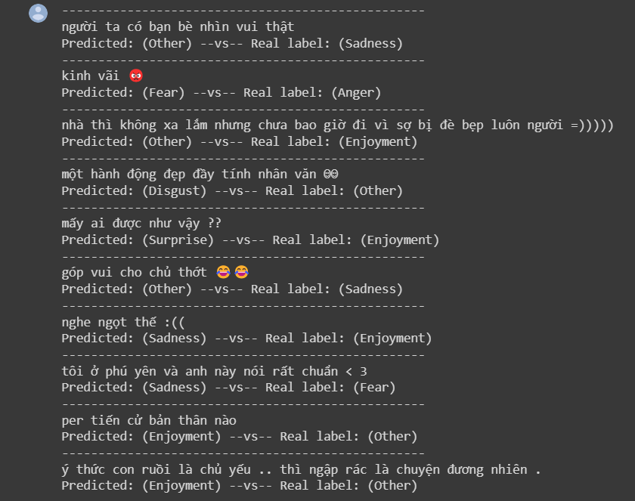
WRONG PREDICTION

Slide 21
REFERENCES
https://github.com/VinAIResearch/PhoBERT
https://curiousily.com/posts/sentiment-analysis-with-bert-and-hugging-face-using-pytorch-and-python/
http://nlp.uit.edu.vn/datasets/
https://skimai.com/fine-tuning-bert-for-sentiment-analysis/

